Slide 1
Twitter sentiment prediction
Nguyen Kim Ngan

Slide 2
Problem
Classify the tweets by implementing any NLP approach for Sentiment analysis. Build a model to predict the sentiment of the tweet.
The objective is to recognize whether the given tweet is oriented as negative (-1), neutral (0), or positive (1) tone.
To solve the problem:
Review data
Clean data
Build a predictive model using deep learning

Slide 3
1. Data overview
The dataset contains 2 columns: clean_text - message tweeted, and category – sentiment for the tweet.
​ | Count | Percentage
Positive tweets | 72249 | 44.3%​
Neutral tweets | 55211 | 33.9%
Negative tweets | 35509 | 21.8%
Total | 162969 | 100%

Slide 4
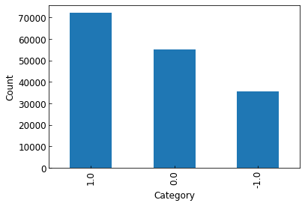
Distribution of twitter sentiment
Positive Neutral Negative
Comment: Positive tweets are the most popular, following by the neutral tone, and the least is negative category.

Slide 5
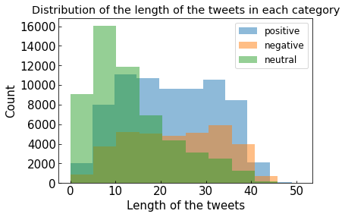
Comment: The neutral tweets are usually short while the others have medium length.

Slide 6
Most frequent words
​ | Count
Positive tweets | Modi, the, and, for, you, india, will, are, that, this
Neutral tweets | Modi, the, and, for, you, will, not, this, india
Negative tweets | Modi, the, and, for, you, not, are, that, this, will
Total | Modi, the, and, for, you, not, will, this, india, are
Comment: ”Modi” is the most frequent word in all categories. Others are mainly stop-words.

Slide 7
2. Data cleaning
Check for NaN values
Remove stop-words
Remove punctuation
Stem the words
Tokenize the words

Slide 8
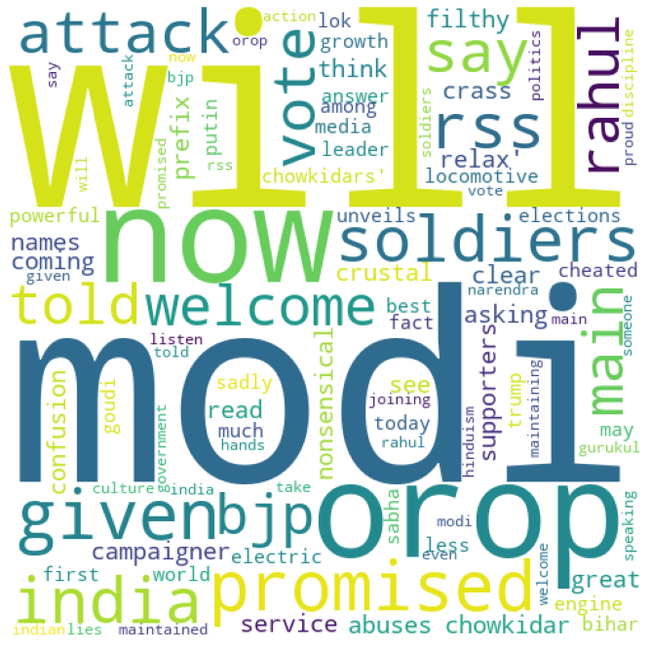
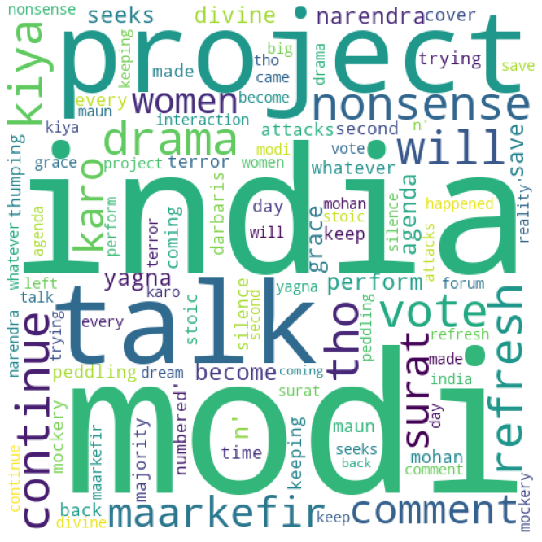
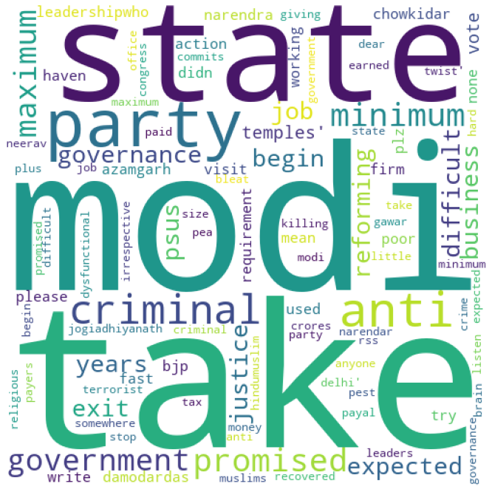
Word cloud after cleaning data
Positive tweets
Neutral tweets
Negative tweets
Comment: Beside ’Modi’, the common words for positive, neutral, and negative tweets are ‘will’, ‘india’ and ‘take’, respectively.

Slide 9
3. Data model
Type of problem: natural language processing, classification
Type of model: sequence

Slide 10
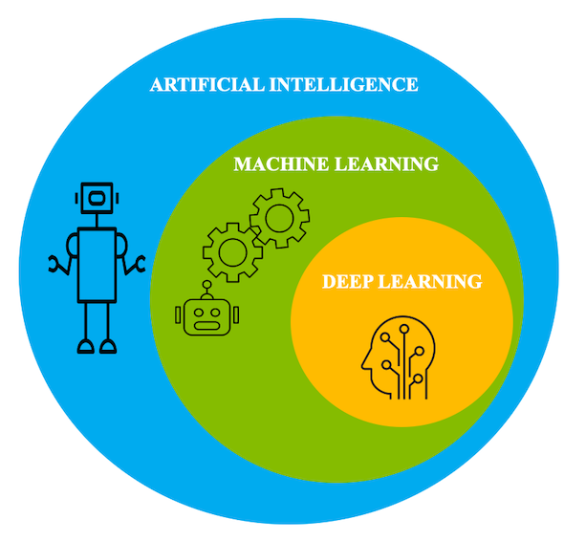
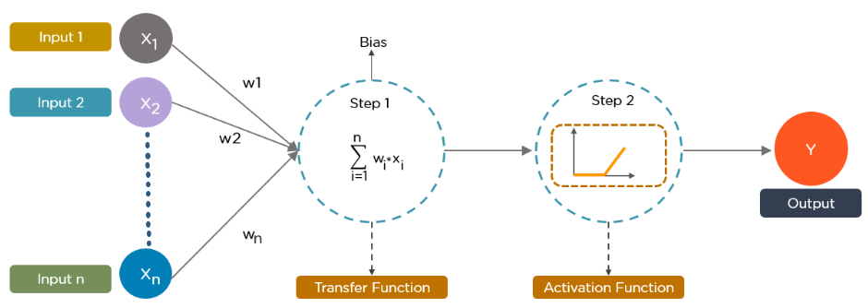
Deep learning can be considered as a subset of machine learning. It is a field that is based on learning and improving on its own by examining computer algorithms. Deep learning works with artificial neural networks, which are designed to imitate how humans think and learn.
Data provides each node with information in the form of inputs. The node multiplies the inputs with random weights, calculates them, and adds a bias. Finally, nonlinear functions, also known as activation functions, are applied to determine which neuron to fire.

Slide 11
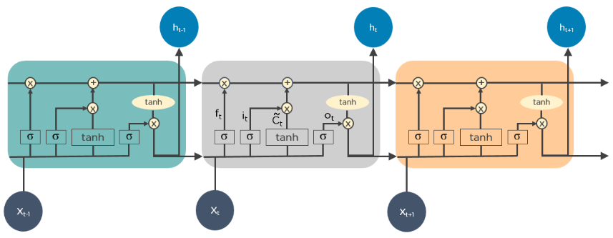
There are different types of algorithms used in Deep learning, including Convolutional neural network (CNN), Recurrent neural network (RNN), Long short-term memory (LSTM), Generative adversarial network (GAN), etc. The most useful algorithms for time-series analysis are RNN and LSTM.
Long short-term memory (LSTM) is an artificial recurrent neural network (RNN) architecture used in the field of deep learning. Unlike standard feedforward neural networks, LSTM has feedback connections. It never keeps the entire data like standard recurrent neural network, LSTM keeps selectively data over time.
More advanced models in natural language processing in the last few years are BERT, RoBERTa, GPT2, etc. However, they require large computing capacity.

Slide 12
sequential model
Input
LSTM layer
Fully connected layer
Output
Embedding layer
Tokenized data are split into Training data & Validation data
Optimizer = adam
Loss = categorical cross entropy

Slide 13
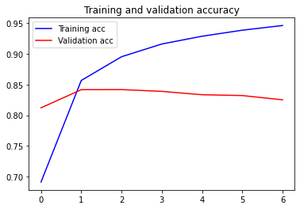
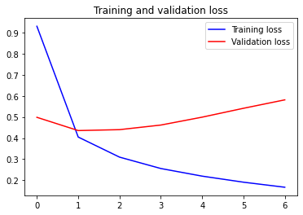
Train model with batch size = 512 for ~ 10 epochs.
Use early_stop allows stopping learning when the validation is not good enough to avoid overfit.
Choose Epoch = 2 → Result: Accuracy 85%
Accuracy
Loss
Epoch
Epoch

Slide 14
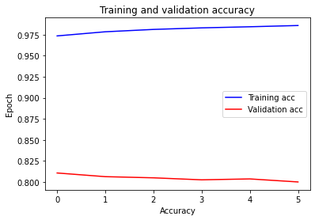
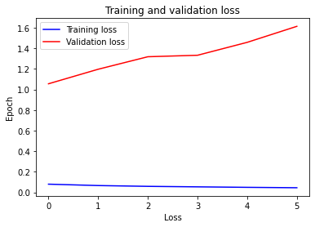
Train model with batch size = 1024 for ~ 10 epochs.
Use early_stop allows stopping learning when the validation is not good enough to avoid overfit.
Accuracy
Loss
Epoch
Epoch

Slide 15
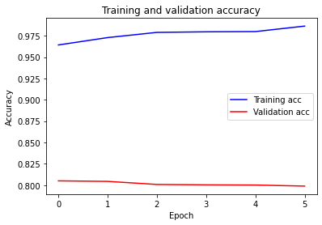
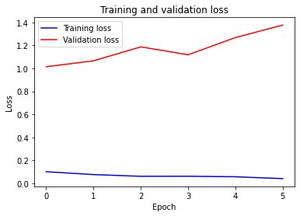
Train model with batch size = 256 for ~ 10 epochs.
Use early_stop allows stopping learning when the validation is not good enough to avoid overfit.

Slide 16
Another method
Data transformation: using TFIDF (options: BOW, Word2vec,…)
Apply ML algorithm: Logistic Regression (useful for classification)
Result: Accuracy 83%
How to improve: Try different algorithms (Naïve bayes, SVM…)

